Slide 1


Informing budget impact analysis in health using R/Shiny
MSc. Alfredo Palacios
Coordinator of Health Economics, Institute for Clinical Effectiveness and Health Policy (IECS)
Associate Professor, Department of Economics, University of Buenos Aires (UBA)
apalacios@iecs.org.ar

Slide 2
Outline
What is budget impact analysis (BIA) in health?
Challenges conducting BIAs in Latin America
BIA Dashboard: Power BI vs. Excel vs. R
The IECS BIA Model in R/Shiny
Demo
Next steps

Slide 3
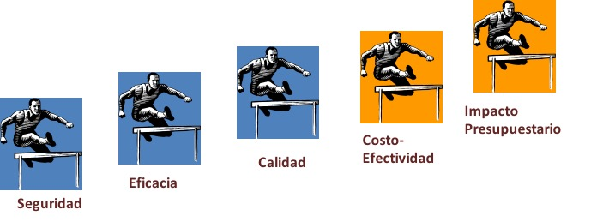
What is budget impact analysis (BIA) in health?
Barriers that must overcome new health technologies before reaching the patient
Affordability
Budget impact
Efficiency
Cost-effectiveness
Cost-utility
Effectiveness
Observational studies
Programmatic clinical studies
Efficacy
Phase III clinical trials
Security
Phase I and II clinical studies

Slide 4
What is budget impact analysis (BIA) in health?
A BIA estimates the financial consequences of adoption and diffusion of a new healthcare intervention within a specific healthcare setting or system context given inevitable resource constraints (Mauskopf et al., 2007).
The BIA is an essential part of a comprehensive economic assessment of healthcare technologies.

Slide 5
Relevance of BIA in Latin America
BIA is increasingly required, sometimes with a CEA, prior to formulary approval or reimbursement.
Brazil, Chile and Colombia published BIA guidelines with local recommendations.
In Uruguay, the National Resources Fund establishes that no drug can enter its lists before complying with certain conditions, including BIA.
In Argentina, the Superintendency of Health Services incorporated the requirement of BIA for requests for new additions in the benefits package.

Slide 6
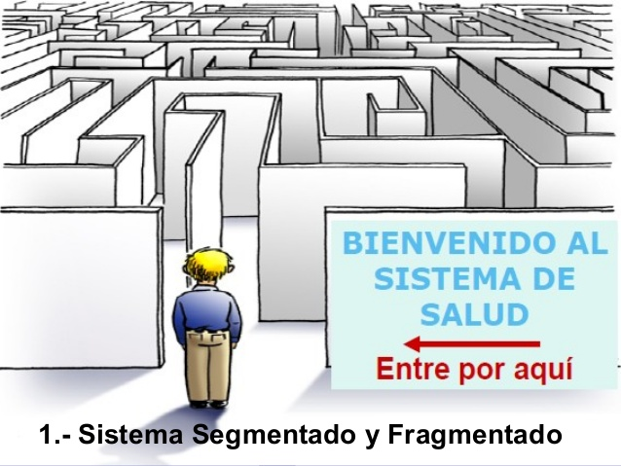
Challenges condunting BIAs in Latin America
WELCOME TO THE HEALTHCARE SYSTEM
Come in here

Slide 7
Challenges condunting BIAs in Latin America
In general, in Latin American countries, health care financing is fragmented and decentralized.
In Argentina: Multiple subsectors and budget holders (with different healthcare costs)
Public sector budget holders: 1 national, 24 provincial
Social security budget holders: ~ 300
Private sector budget holders: >70
BIAs must be specific to a health budget holder / subsector.

Slide 8
BIA Dashboard: Power BI vs. Excel vs. R
If we want to inform health coverage decision-making in a fragmented and decentralized health system, we need a dashboard.
Multiple options: Power BI, Excel, R, others.
In this case we do not need complex methods, nor efficiency, among other attributes…

Slide 9
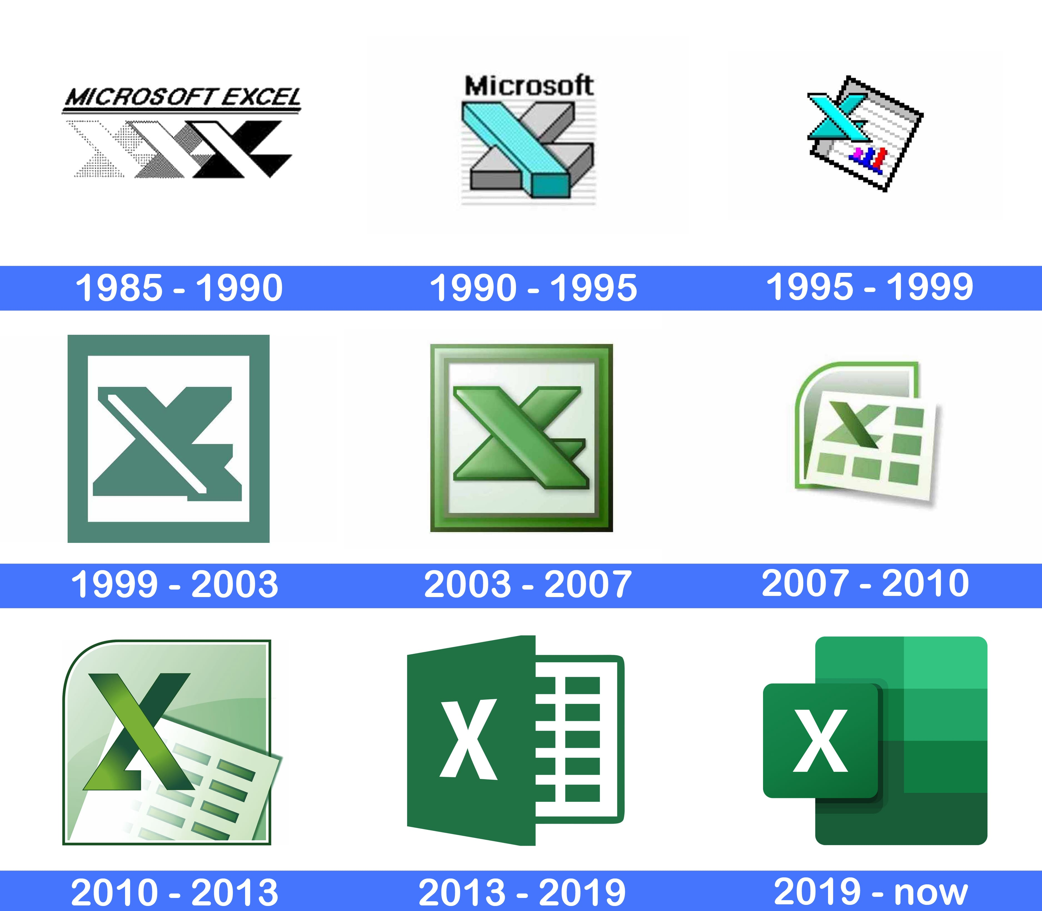
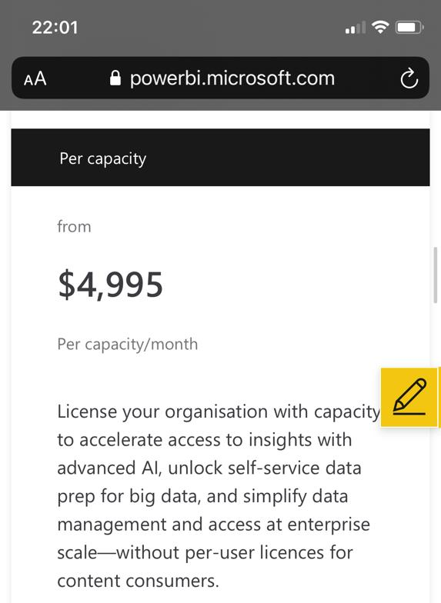
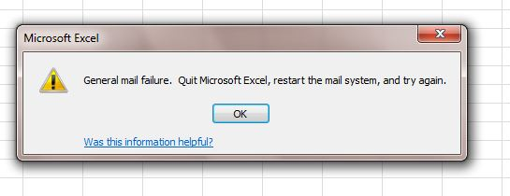
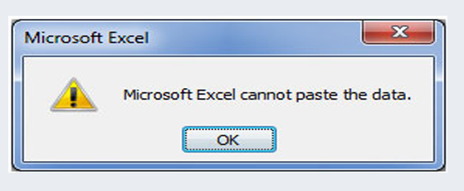
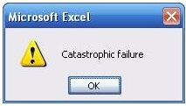
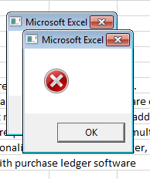
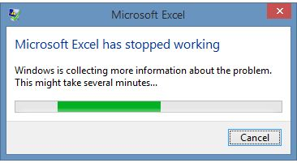

BIA Dashboard: Power BI vs. Excel vs. R
However, R has other advantages compared to Power BI and Excel in the context of multiple budget holders in LMICs...

Slide 10
The IECS budget impact model
Own development of IECS
Developed in R/Shiny
Free for academic purposes (not for commercial use)
Link: https://www.iecs.org.ar/aip/
Enter the following password (all capitalized): IECS2024
At the moment only available in Spanish

Slide 11
Demo

Slide 12
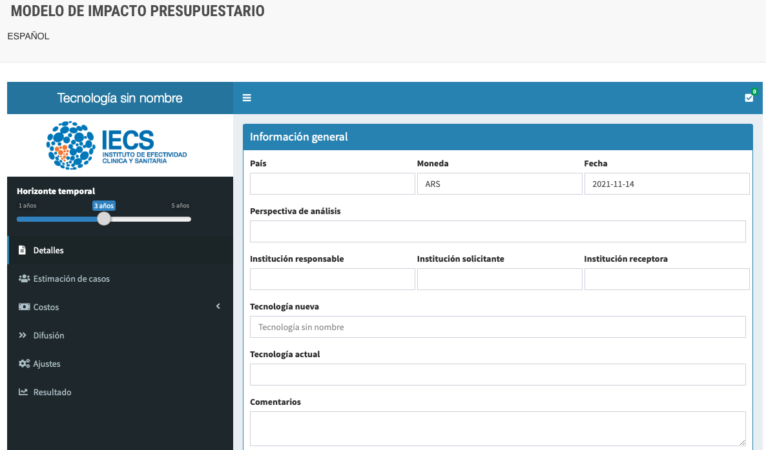
Interface of the Web-based BIA model

Slide 13
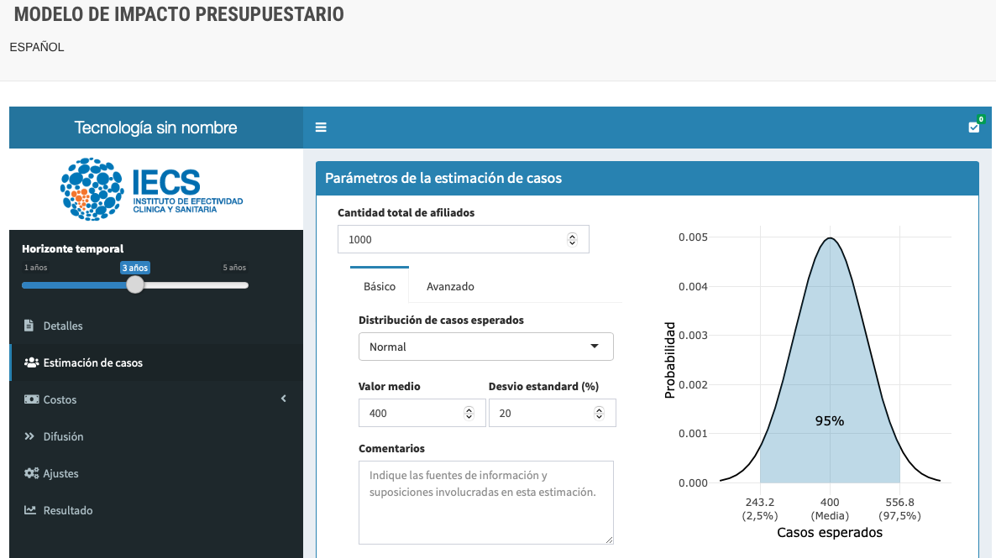
Interface of the Web-based BIA model: Target population

Slide 14
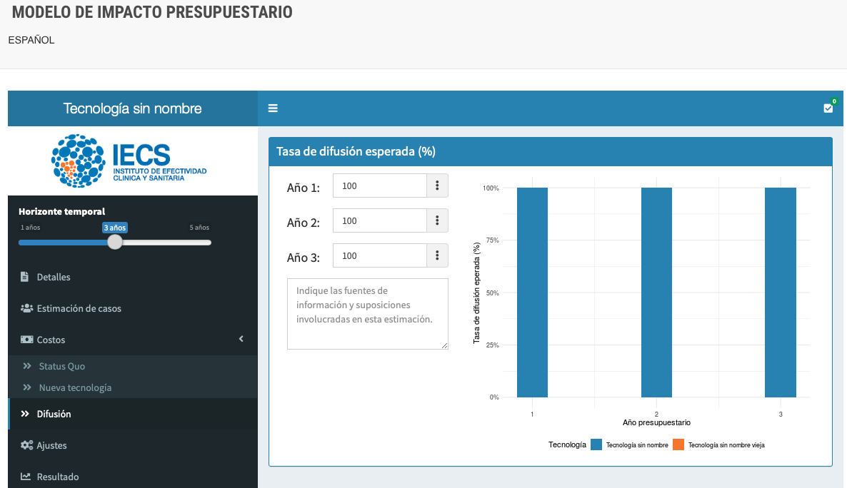
Interface of the Web-based BIA model: Diffusion rate

Slide 15
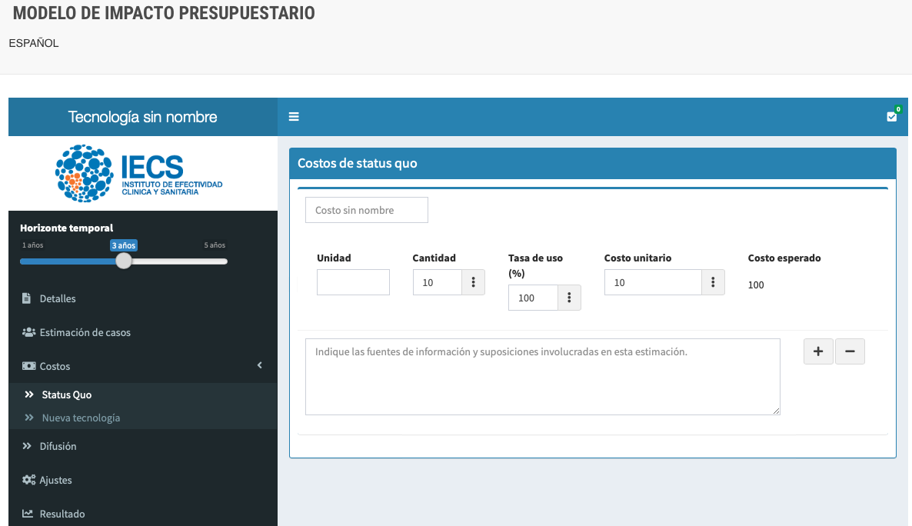
Interface of the Web-based BIA model: Costs of the actual technology

Slide 16
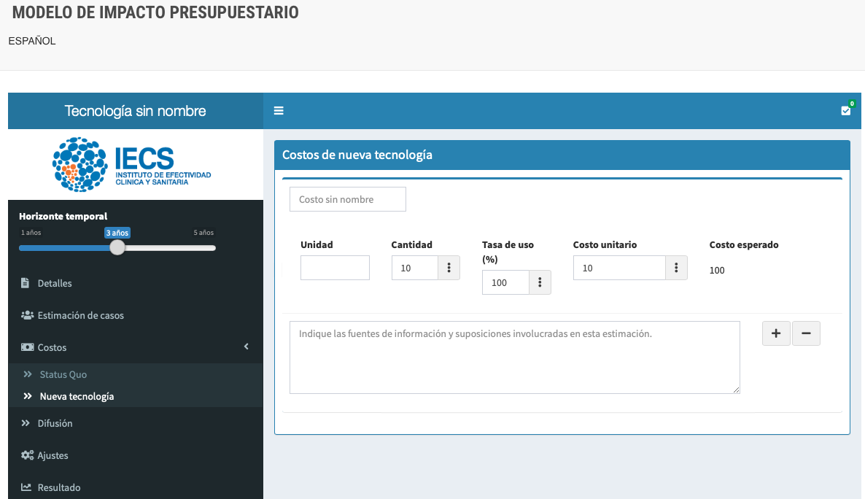
Interface of the Web-based BIA model: Costs of the new technology

Slide 17
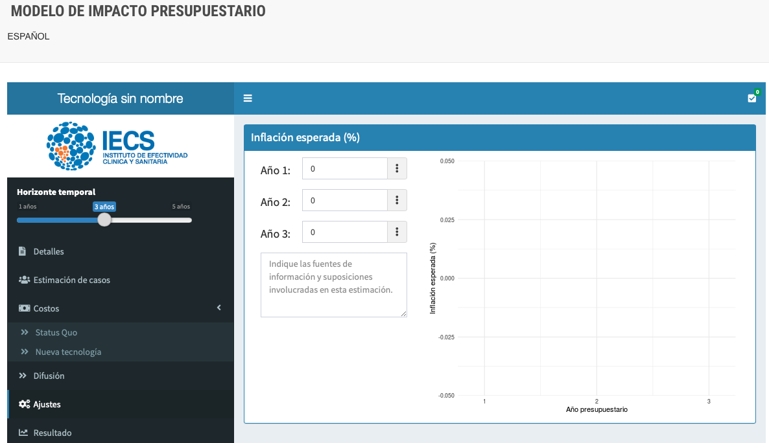
Interface of the Web-based BIA model: Inflation rate

Slide 18
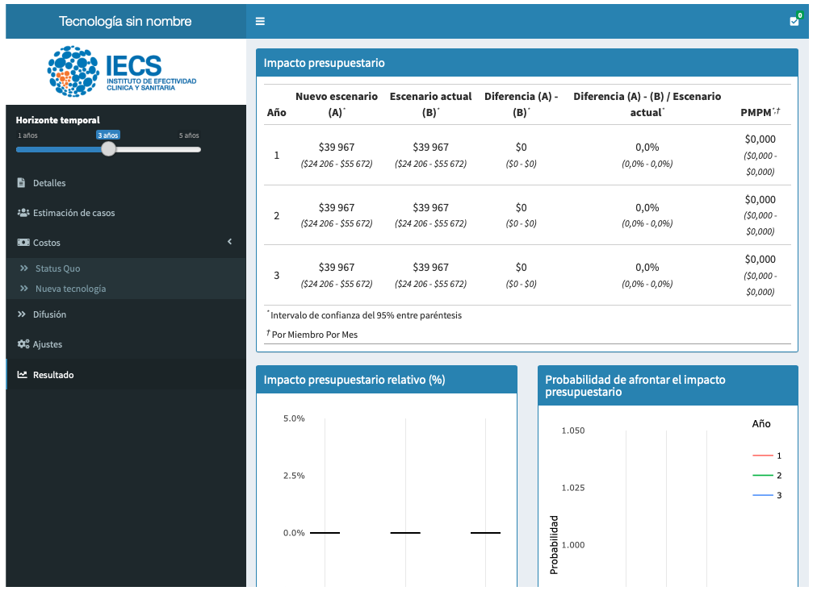
Interface of the Web-based BIA model: Results

Slide 19
Summary
BIA is increasingly relevant in Latin American countries
Challenges for conducting BIA: our healthcare systems are fragmented and decentralized (hundreds of third party-payers)
R could be useful (and flexible) to inform budget impact and coverage decision in health and healthcare

Slide 20
Next steps
More languages
More than one comparator
Deterministic sensitivity analysis
High budget impact thresholds
Report in .doc or .pdf

Slide 21


Thank you!
Contact details:
apalacios@iecs.org.ar
alfredopalacios13
AlfrePalacios13

